Slide 1
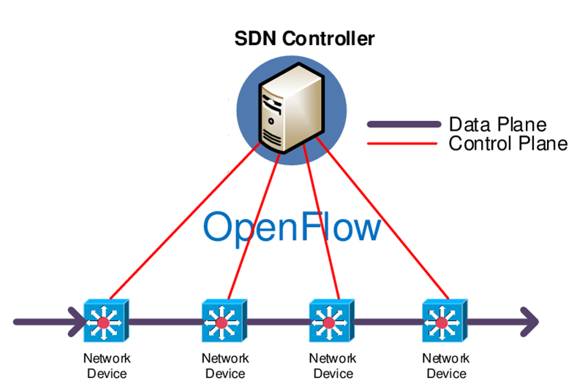
Software Defined Networking
Lecture 8
SoftUni Team
Technical Trainers
Software University
http://softuni.bg

Slide 2
Table of Contents
Traditional networking
Software Defined Networking (SDN)
Simulators for SDN
Demonstration

Slide 3
Traditional networking

Slide 4
The old (current) way of doing networking
Networking vendors sell proprietary hardware
Hardware can be different, but devices talk to each other using protocols
These protocols are built in the OS/image in each device
We need to separately configure the logic for each “box” by using:
Command Line Interface (CLI)
Some kind of Network Management System (NMS)

Slide 5
How network devices make forwarding decisions
Switches and routers should decide where to send a particular packet so each device may need to consider, build or change:
MAC address tables
Routing tables
Use ARP to find the destination MAC
Decrease the TTL of each packet
Different planes on each device are responsible for the different tasks: control plane, data plane and management plane

Slide 6
Devices and planes
Control plane (the brain). Responsible for:
Building ARP tables
Building routing tables
Running STP to avoid loops
Data plane (the muscles). Responsible for:
Encapsulation/decapsulation
Adding or removing headers (802.1Q for example)
Replace source/destination address (if there is NAT)
Management plane - used for accessing and managing the devices. Examples - Telnet, SSH

Slide 7
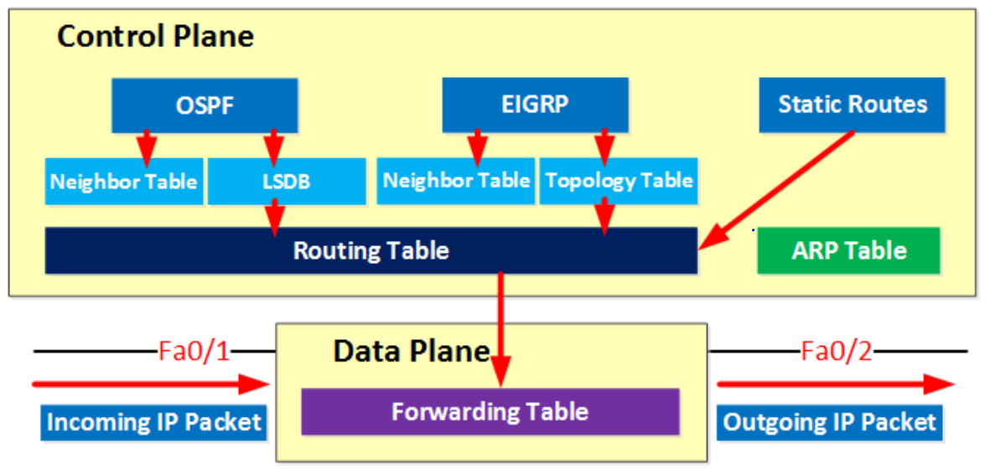
The control and the data planes

Slide 8
Limitation of traditional networking
When adding a new service/server in the network, this may lead to creating and configuring:
VLAN
STP
Subnet
Routing
Firewall rules (ACL)
Etc…
The whole process is slow, manual and may lead to configuration errors

Slide 9
Software Defined Networking (SDN)

Slide 10
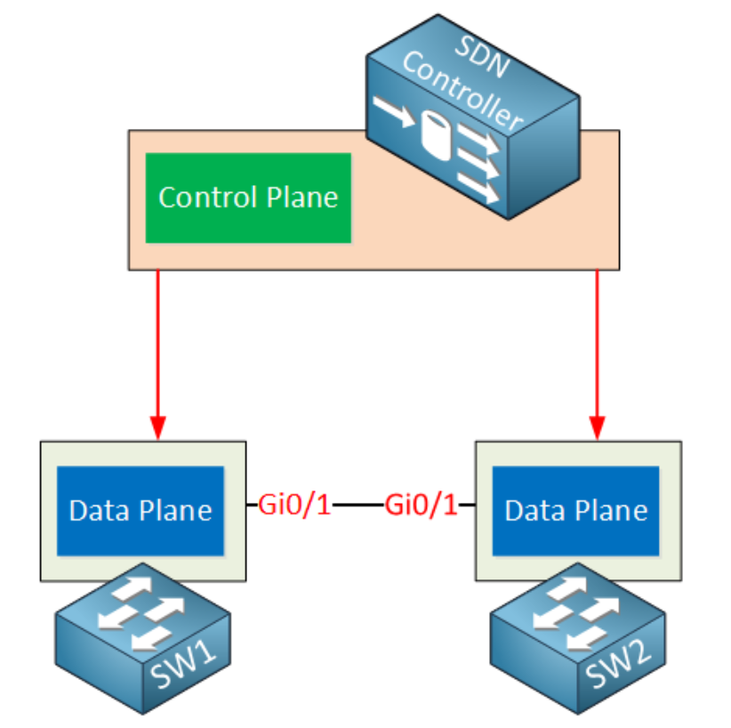
What is SDN?
SDN - Software Defined Networking
SDN uses a centralized control plane - SDN controller

Slide 11
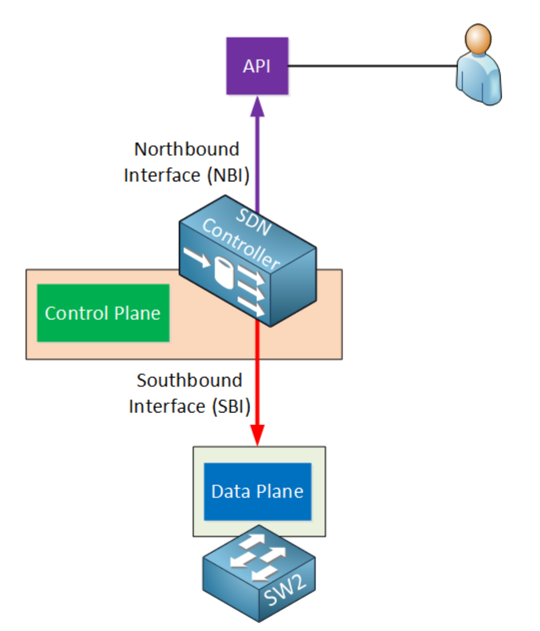
SDN controller interfaces
Northbound Interface (NBI)
Used to access and program the controller
Can have GUI, CLI and API
You can write scripts for automation
Southbound Interface (SBI)
The controller’s communication with the “dumb” devices
It is a software interface, often API

Slide 12
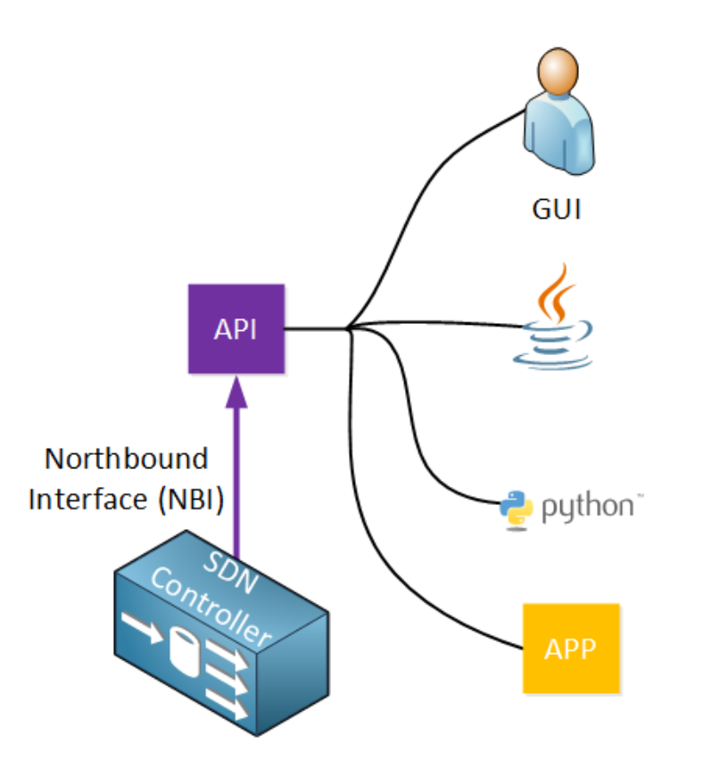
SDN northbound interface
The interface allows multiple applications to access the controller:
GUI
Java/Python or other scripts
3rd party apps
REST API (next slide) is typically used

Slide 13
REST API
REST - Representational State Transfer
REST API uses HTTP messages to send and receive information between SDN controller and another application
Examples for such messages:
HTTP GET: used when we want to retrieve information
HTTP POST/PUT: used when we want to upload or update information
The two most used data formats are:
JSON (JavaScript Object Notation)
XML (eXtensible Markup Language)

Slide 14
SDN southbound interface
This is the controller’s communication with the “dumb” hardware
It specifies a software (not a physical) interface
Some popular southbound interfaces:
OpenFlow
Cisco OpFlex
CLI (in the APIC-EM controller)

Slide 15
SDN OpenFlow

Slide 16
Simulators for SDN

Slide 17
Mininet and miniedit
What you need:
Mininet image
Virtualization software, for example VirtualBox
Terminal emulator software, for example PuTTY
X11 display server, for example Xming
sudo ~/mininet/examples/miniedit.py
Patience…

Slide 18
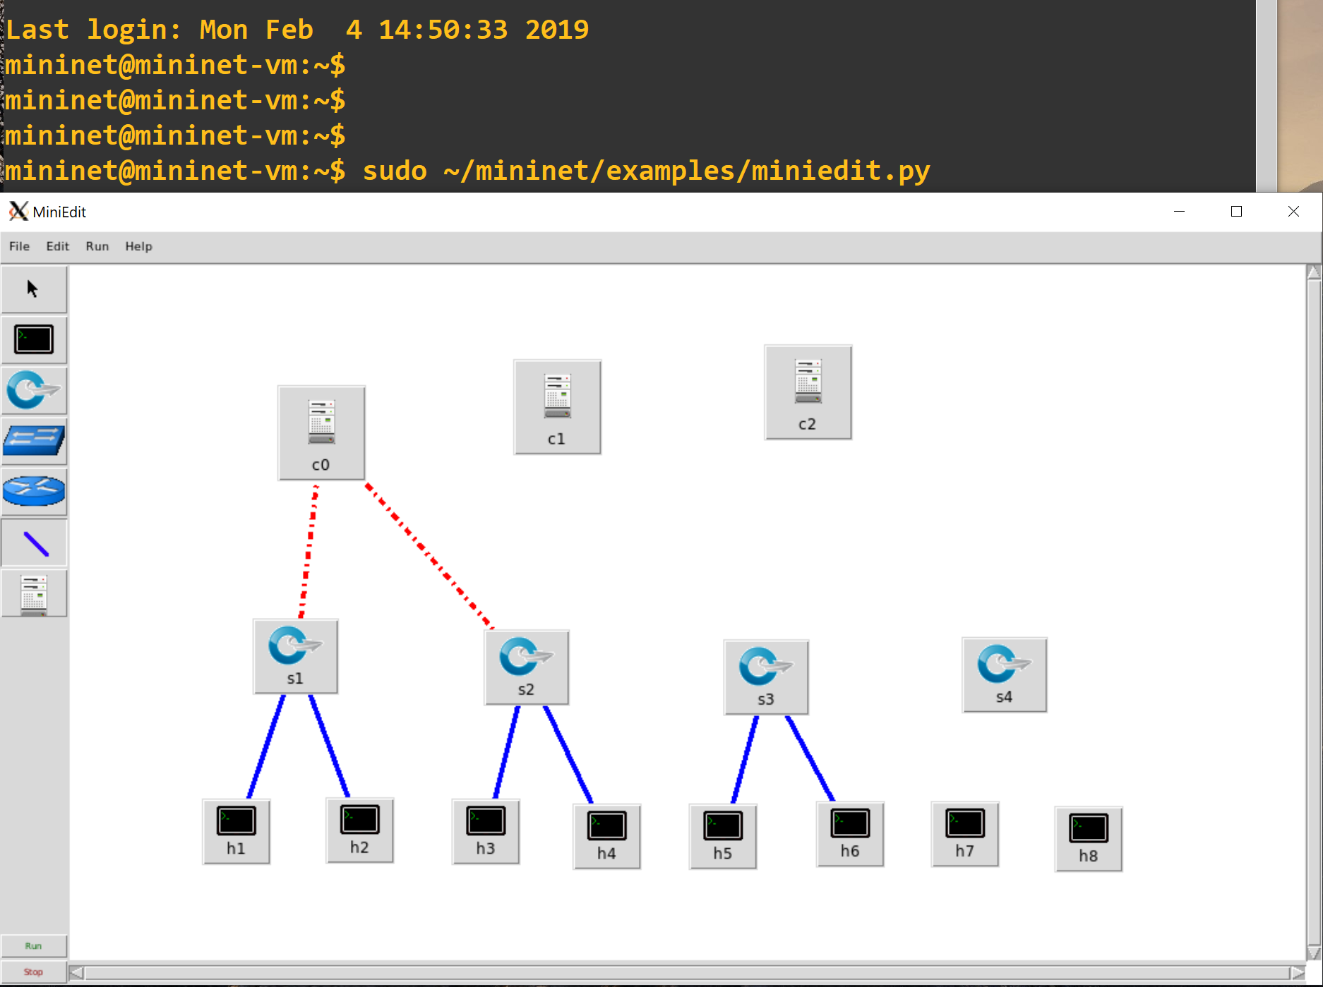
Mininet and miniedit (2)

Slide 19
HPE VAN SDN controller and Mininet
What you need:
HPE VAN SDN controller appliance
Mininet image
Connectivity between both VMs and the host
Browse to the controller: https://ip_address:8443/sdn/ui (user: sdn, password: skyline)
Login to Mininet and type: sudo mn --controller=remote,ip= --topo=linear,4 --mac

Slide 20
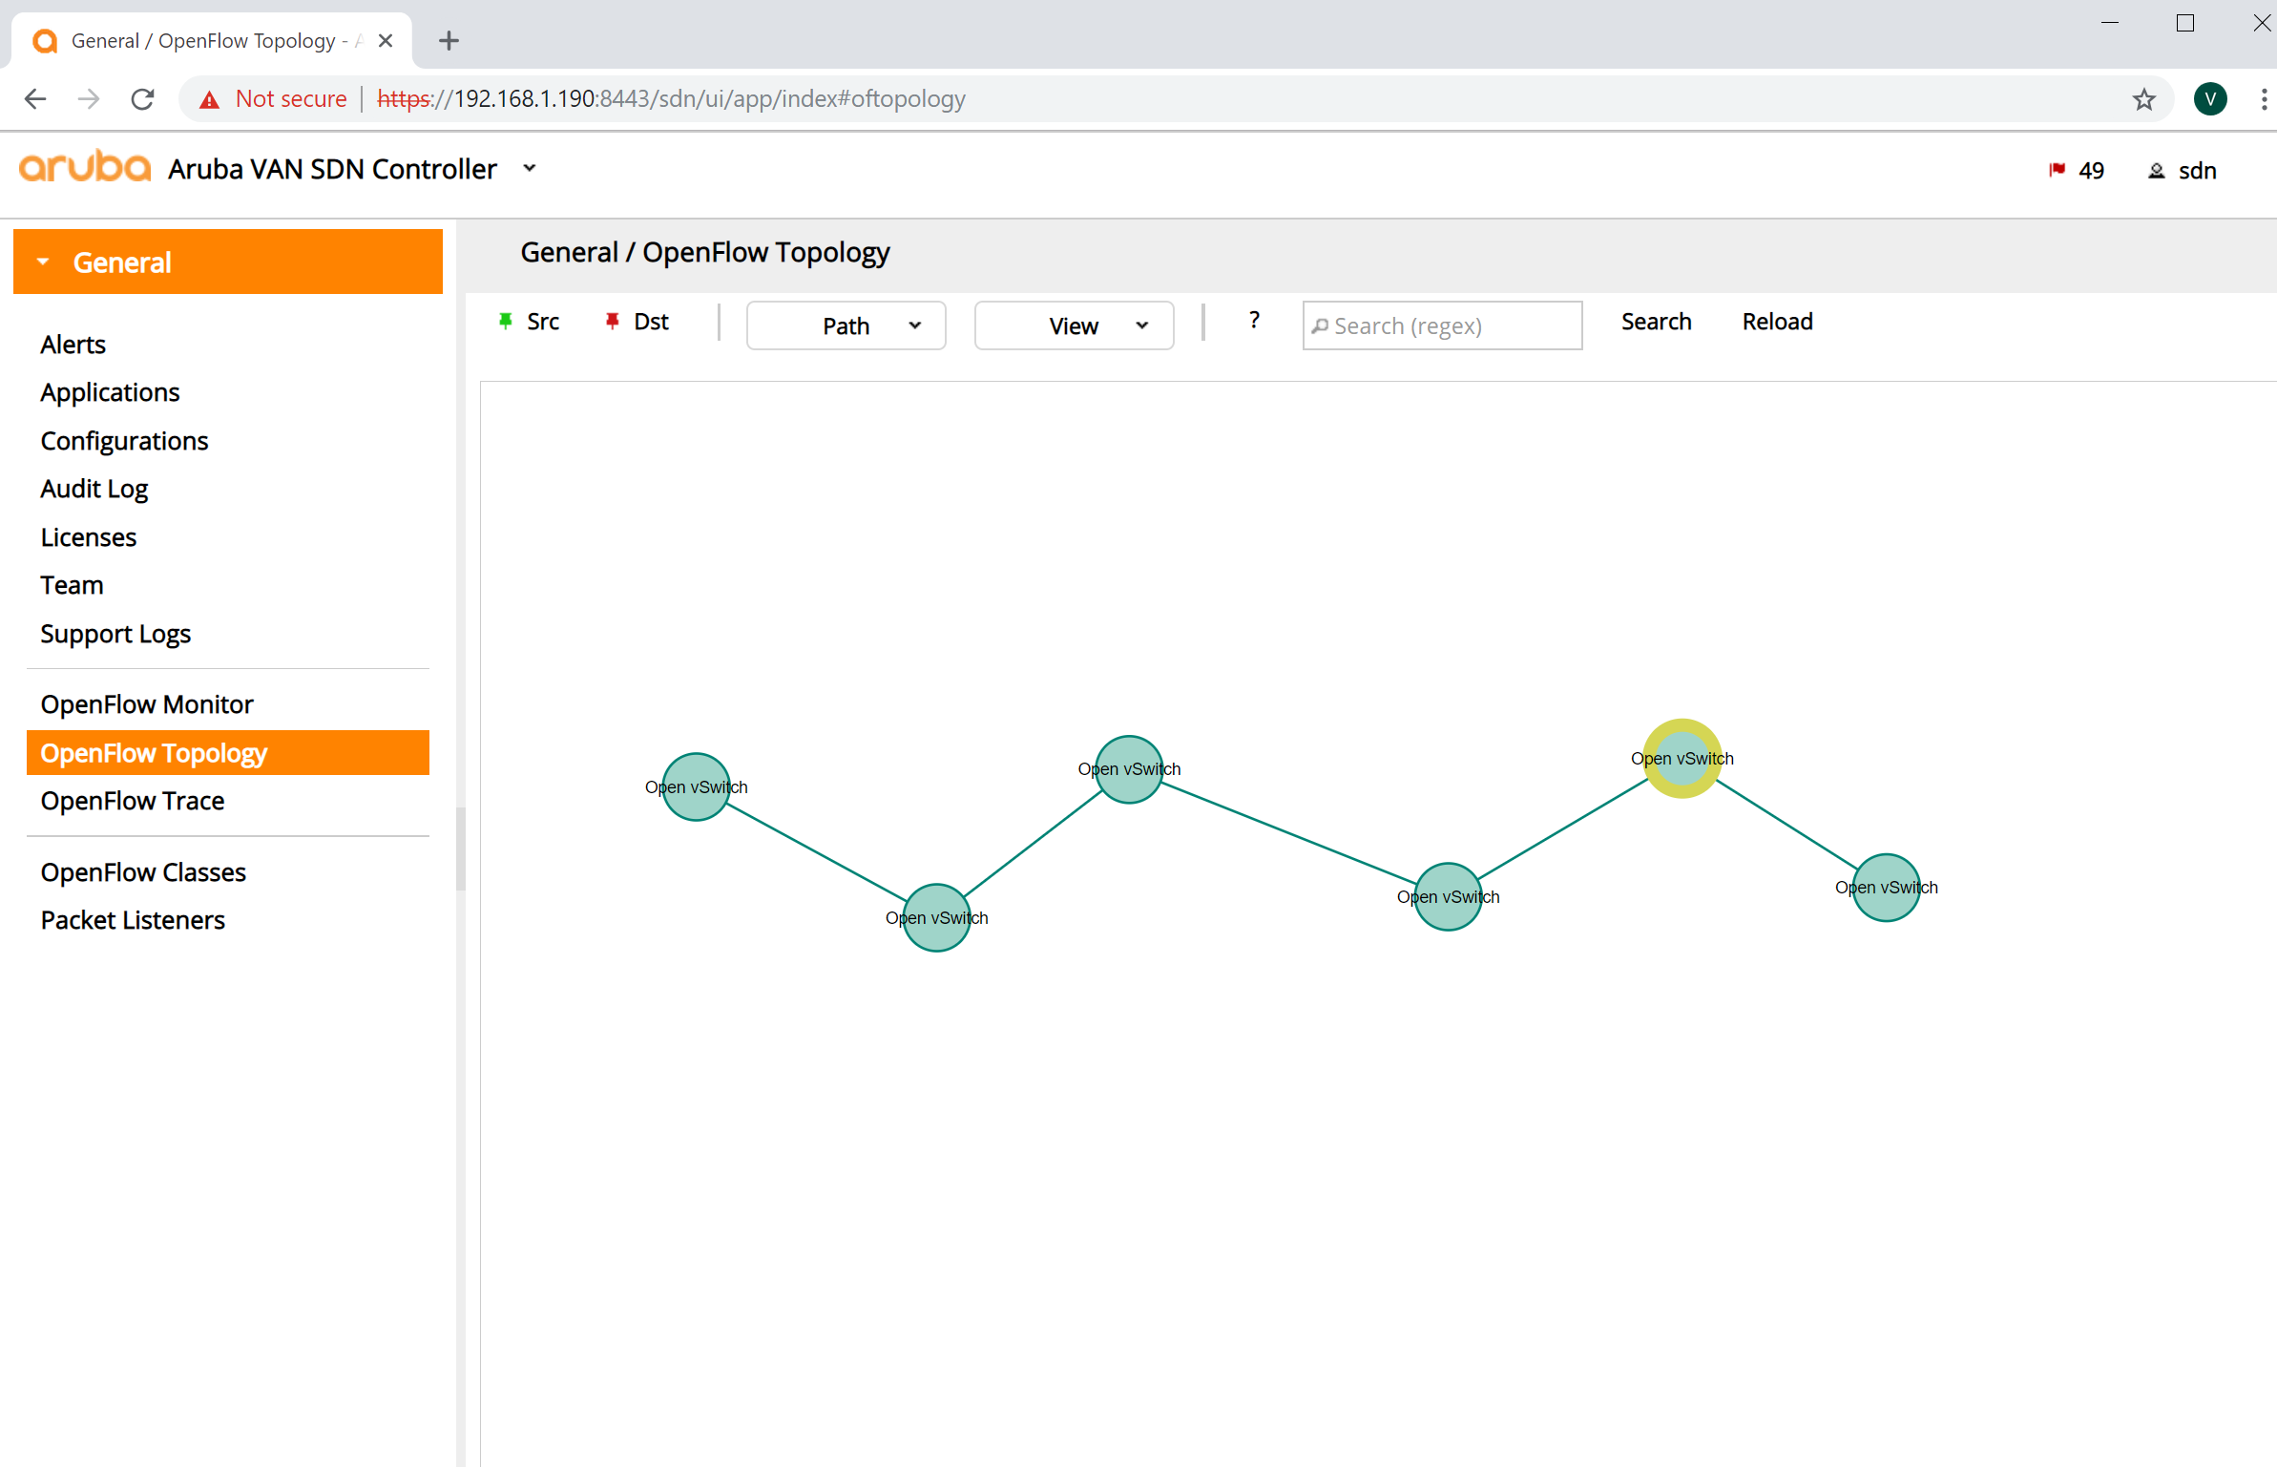
HPE VAN SDN controller and Mininet (2)

Slide 21
Cisco APIC-EM
APIC-EM: Application Policy Infrastructure Controller - Enterprise Module
Created to be used with existing hardware
Uses REST API for the northbound interface
Uses common protocols, like SNMP, Telnet, SSH, for the southbound interface
Can be installed from an iso image
There are labs which does not require local installations

Slide 22
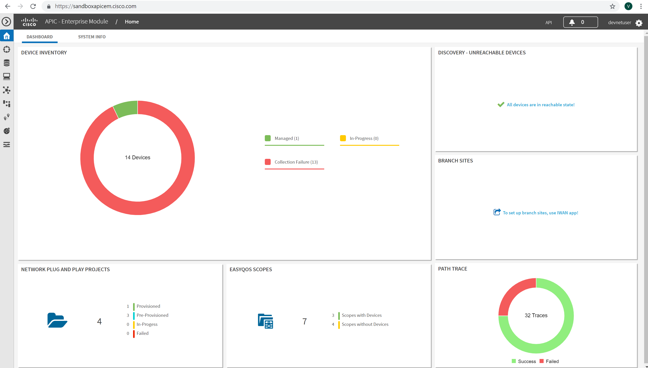
Cisco APIC-EM (2)

Slide 23
VMWare NSX
NSX is network virtualization platform, which provides:
You can try the VMware NSX Data Center for free (enable browser pop-ups)
Logical switching | Logical load-balancer
Logical routing | Logical VPN
Logical firewall and NSX gateway | NSX API

Slide 24
Demonstration

Slide 25

Summary
Traditional networking
Software Defined Networking (SDN)
Simulators for SDN
Demonstration
…
…
…

Slide 27



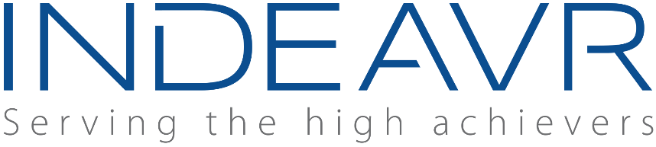





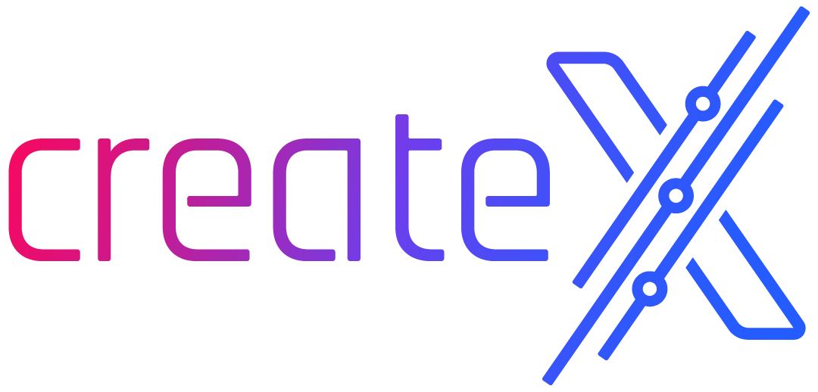

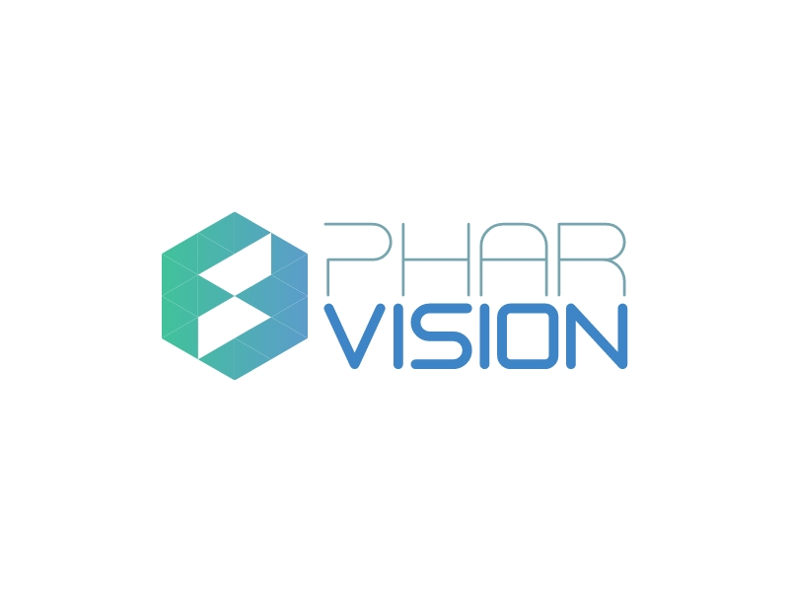
SoftUni Diamond Partners

Slide 28
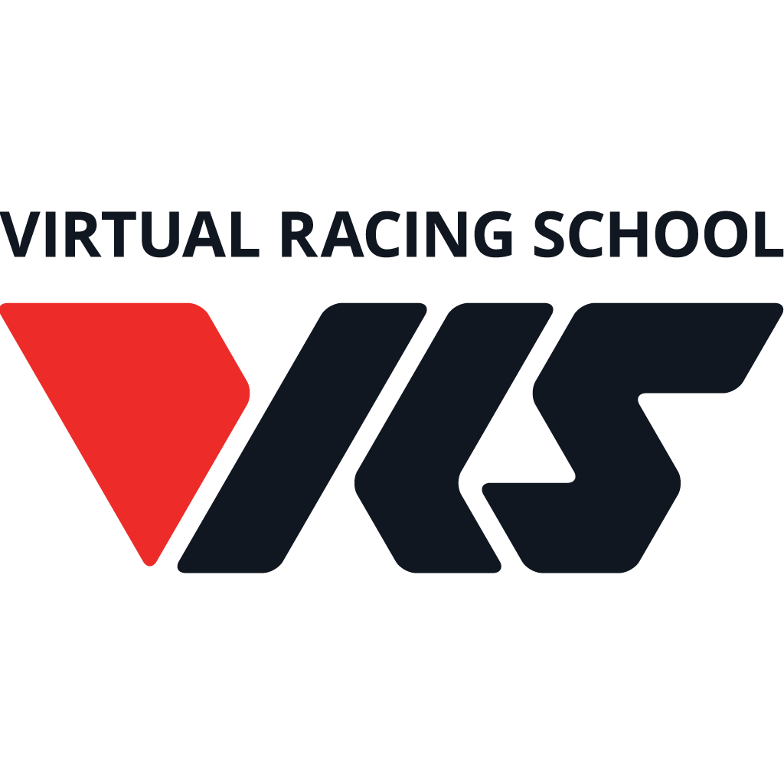

Educational Partners

Slide 29
Trainings @ Software University (SoftUni)
Software University – High-Quality Education, Profession and Job for Software Developers
softuni.bg, about.softuni.bg
Software University Foundation
softuni.foundation
Software University @ Facebook
facebook.com/SoftwareUniversity
Software University Forums
forum.softuni.bg
Notes:
29

